Slide 1
Social Identity, Personality, and Gender
Dr. Krause
http://digital.films.com.db26.linccweb.org/p_ViewVideo.aspx?xtid=115831&tScript=0
http://digital.films.com.db26.linccweb.org/p_ViewVideo.aspx?xtid=40835&tScript=0#

Slide 2

Questions for You
Are you normal???

Slide 3
Questions for You
What does your name mean to you?

Slide 4
Self-Awareness
Self-awareness is the ability to identify oneself as an individual, to reflect on oneself, and to evaluate oneself.

Slide 5
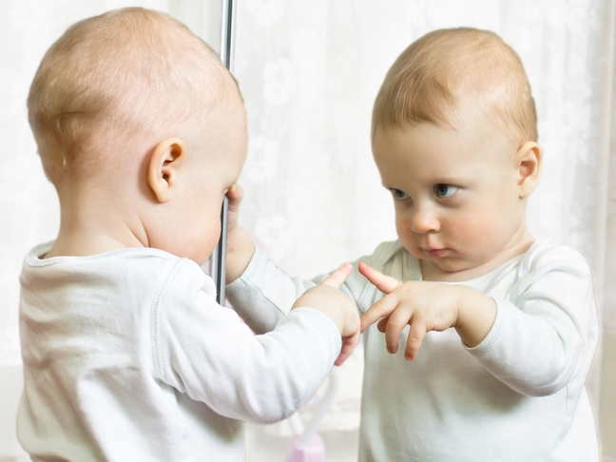
CONSIDER THIS
Recognizing herself in the mirror, this young girl has developed the self-awareness necessary to understand that she is a distinct individual.
In modern industrial and post-industrial societies, self-awareness is typically established by about age 2—later than in other societies.
Why do you think self-awareness is later in post-industrial societies?

Slide 6
Question: How do you define personality?

Slide 7
Question: How do you define personality?
Personality is the distinctive way that a person thinks, feels, and behaves.

Slide 8
Enculturation and Self-Awareness
Enculturation, the process by which individuals become members of their society, begins soon after birth:
  For enculturation to proceed, individuals must possess self-awareness, the ability to perceive and reflect upon themselves as individuals.

Slide 9
Personal Naming
Personal names are important devices for self-definition in all cultures:
  Many cultures mark the naming of a child with a special event or ritual known as a naming ceremony.

Slide 10
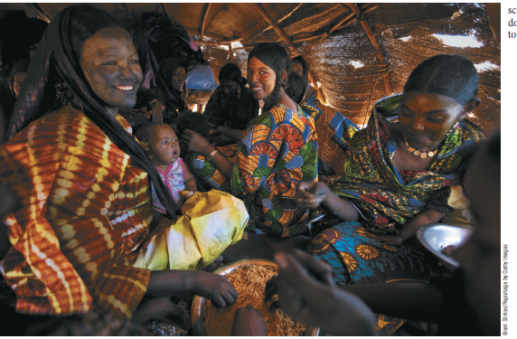
Personal Naming
Personal names are important devices for self-definition in all cultures.
Many cultures mark the naming of a child with a special event or ritual known as a naming ceremony.
What about your name? What status does it mark?

Slide 11
Self-Awareness and Orientations
The development of self-awareness involves:
  Object orientation: cultural meaning assigned to material objects.
  Spatial orientation: ability to get from one space or object to another.
  Temporal orientation: gives people a sense of their place in time.
  Normative orientation: moral values, ideals, and principles assigned cultural importance.

Slide 12
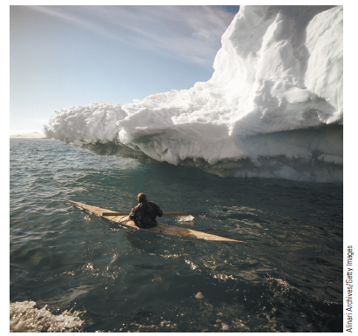
Spatial Orientation
Born and raised in the Arctic, Inuit and other Eskimos find many meaningful reference points in a region that appears endlessly empty and monotonous to outsiders. Without spatial orientation, one would soon be lost and surely perish.
Could you find your way in and out of ice coves without a GPS?

Slide 13
Culture and Personality
Personality is the distinctive way a person thinks, feels, and behaves:
  Most anthropologists believe that early childhood experiences play a key role in shaping adult personality.
  Mead concluded that biology is not destiny through cross-cultural studies in Papua New Guinea.

Slide 14
Dependence Training
Dependence training socializes people to think of themselves in terms of the larger whole:
  Its effect is to create community members whose idea of selfhood transcends individualism, promoting compliance in the performance of assigned tasks and keeping individuals within the group.
  It is found frequently in subsistence farming and foraging societies.

Slide 15
Independence Training
Independence training fosters individual self-reliance and personal achievement:
  It is typically associated with societies in which a basic social unit consisting of parent(s) and offspring fends for itself.
  Independence training is particularly characteristic of mercantile (trading), industrial, and postindustrial societies where self-sufficiency and personal achievement are important traits for success.

Slide 16
Interdependence Training
Interdependence training is a combination of independence and dependence training. The child-rearing practices are meant to promote the key value of being an interdependent member of society – capable of acting alone but cherished by the group:
  A good example of an interdependent society is the Beng of West Africa.

Slide 17
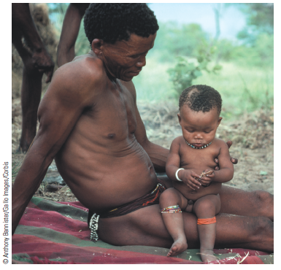
Childrearing among the Ju/’hoansi
In traditional Ju/’hoansi society, fathers as well as mothers show great indulgence to children, who do not fear or respect male authority any more than female authority.
Societies such as the traditional nomadic Ju/’hoansi are associated with dependence training.

Slide 18
Group Personality
We can speak of a cultural personality, as long as we do not expect to find homogeneous traits:
  In larger and more complex societies, it is common to find a generalized range of acceptable individual personality. This is called a group personality.
  Each individual develops certain personality traits that resemble others within the society, yet likewise acquires distinct personality traits because of unique experiences.

Slide 19
National Character
National character studies have focused on the general characteristics of modern countries. Much of this work was associated with the Culture-and-Personality approach popular in the 1930s and 1940s.
  Many anthropologists believe national character theories are based on unscientific data.
  Others choose to focus on the core values promoted in particular societies while recognizing that success in instilling these values in individuals may vary considerably.

Slide 20
Core Values
The core values approach—each society has core values (values especially promoted by a particular culture) and which mark the personalities of those who live there.

Slide 21
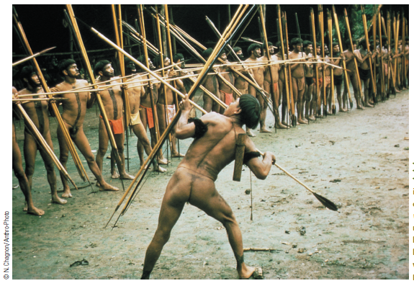
Culture and Personality
Yanomami Indians living in the Amazon rainforest of Venezuela show off as waiteri in a public performance befitting the traditional warrior ideal in their culture.
What ritualized behavior do you associated with your own culture?

Slide 22
Your text presents rugged individualism as a core value in the United States. What does this mean to you? Do you agree?

Slide 23
Culture-bound syndromes are mental disorders specific to particular ethnic groups. They are also called ethnic psychosis.
  The Windigo psychosis is limited to northern Algonquian Indian groups such as the Cree and Ojibwa:
    In their traditional belief systems, these Indians recognized the existence of cannibalistic monsters called windigos.
    Individuals afflicted by the psychosis developed the delusion that they were themselves transformed into windigos, with a craving for human flesh.

Slide 24
  Can you think of any “culture-bound syndromes” that may exist in our culture?
  How does our culture today promote or discourage mental health?

Slide 25
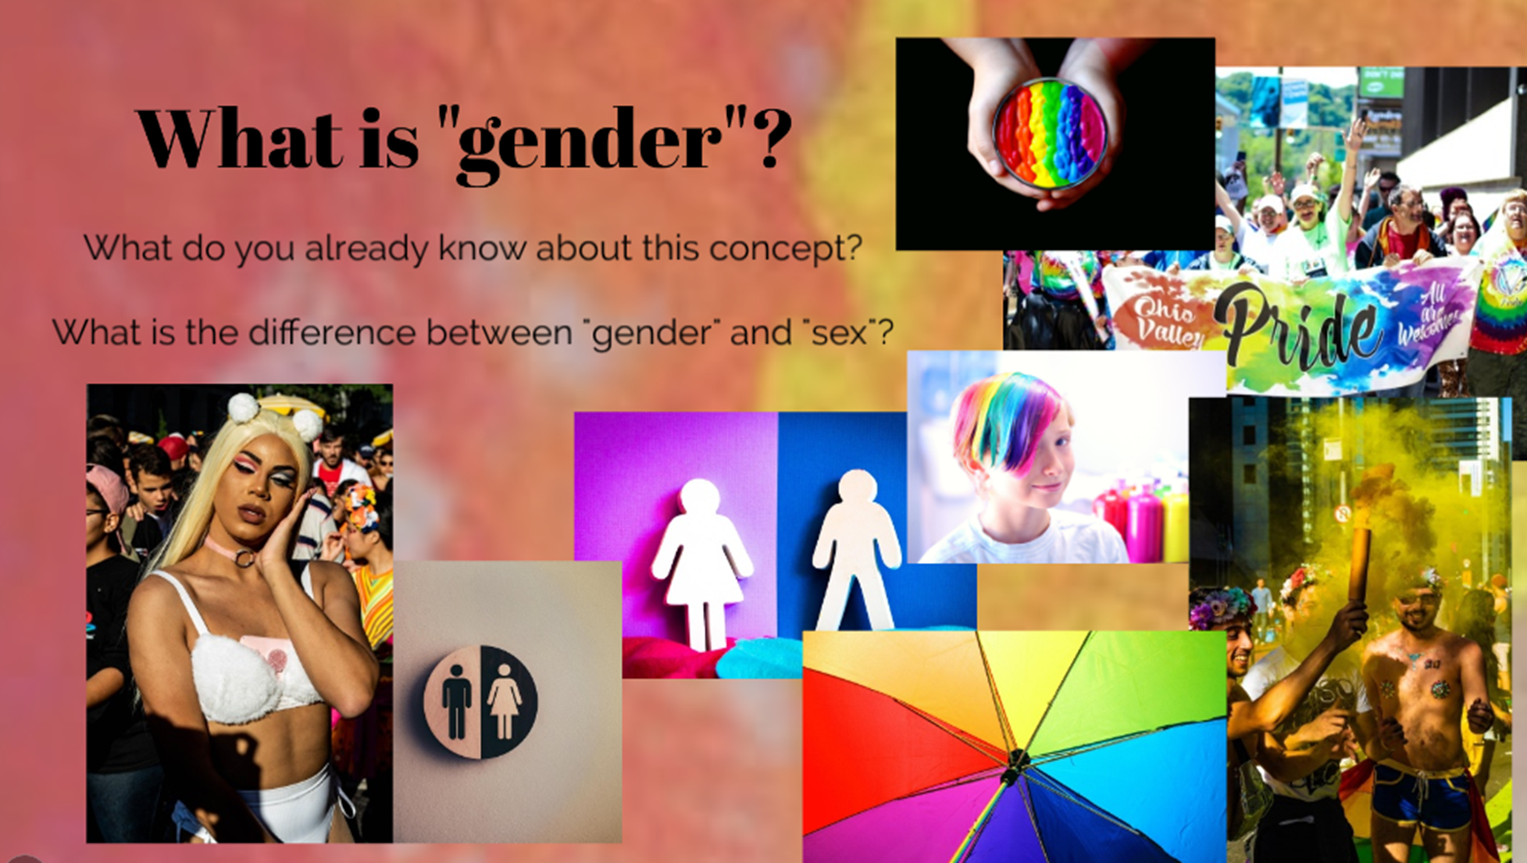

Slide 26
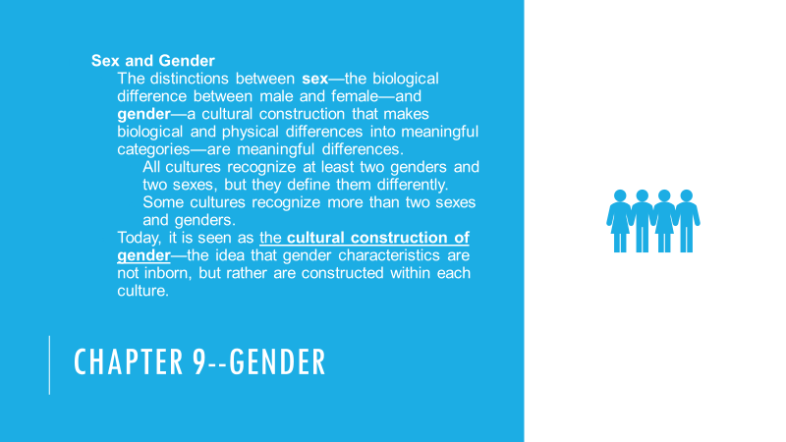

Slide 27
Sex and gender alternatives occur under many different circumstances
It can be associated with societies where all individuals are believed to have unique characteristics (Native American groups and Polynesia).
It can be associated with societies where an individual’s public role is more important than the private one (Thailand).
It can be associated with societies where there are ideologies that tolerate ambiguity (Hinduism).

Slide 28
Sex and gender alternatives occur under many different circumstances
It can be associated with societies where gender differentiation is high (Brazil).
It can be associated with societies where transformation is highly valued between humans and animals (African and diasporic African cultures).
It can be associated with societies where androgyny is considered sacred (Southeast Asia).
It can be associated with societies where maintenance of the patrilineage is the highest concern (Ibo of Nigeria).

Slide 29
Alternative Genders
Intersexuals are individuals who do not fit neatly into either a male or female biological standard or into a binary gender standard.
Transgenders are people who occupy a culturally accepted intermediate position in the binary male–female gender construction.
  Many cultures have created social space for transgendered individuals who are culturally accepted as a third gender category.

Slide 30
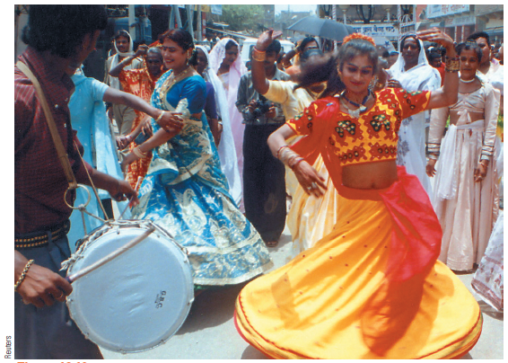
Transgenders
These elegantly dressed street performers are eunuchs, part of a broad alternative gender category in India known as hijras. The exact number of eunuchs in India is unknown, but estimates range from 500,000 to 1 million.
What is the role of gender in our culture today?

Slide 31
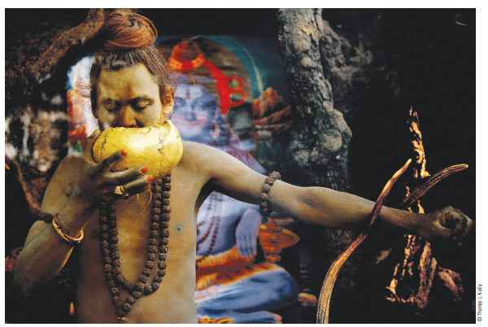
What is the role of normal and abnormal behavior in religious context in our society?
Although we may disagree on specific incidents, in the institution of religion we are more tolerant of what would be called “abnormal behavior.”
People can be different (abnormal) because they are somehow influenced by the supernatural.

Slide 32
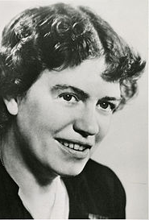
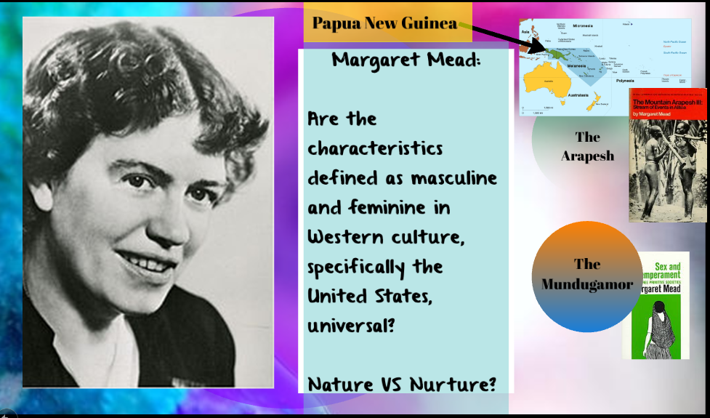
Margaret Mead
*the question of whether the characteristics defined as masculine and feminine in Western culture, specifically the United States, were universal.
Her studies in New Guinea showed that:
  Among the Arapesh, men and women both were expected to act in ways that Americans considered “naturally” feminine
  In Mundugamor society, both sexes were what American culture would call “masculine.”
  http://digital.films.com.db26.linccweb.org/p_ViewVideo.aspx?xtid=2545&tScript=0

Slide 33
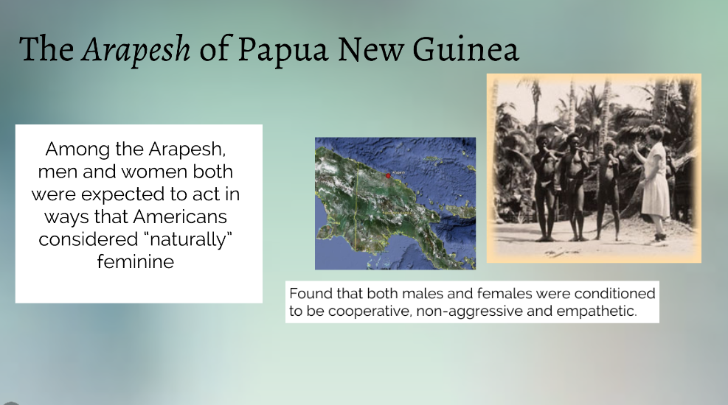

Slide 34
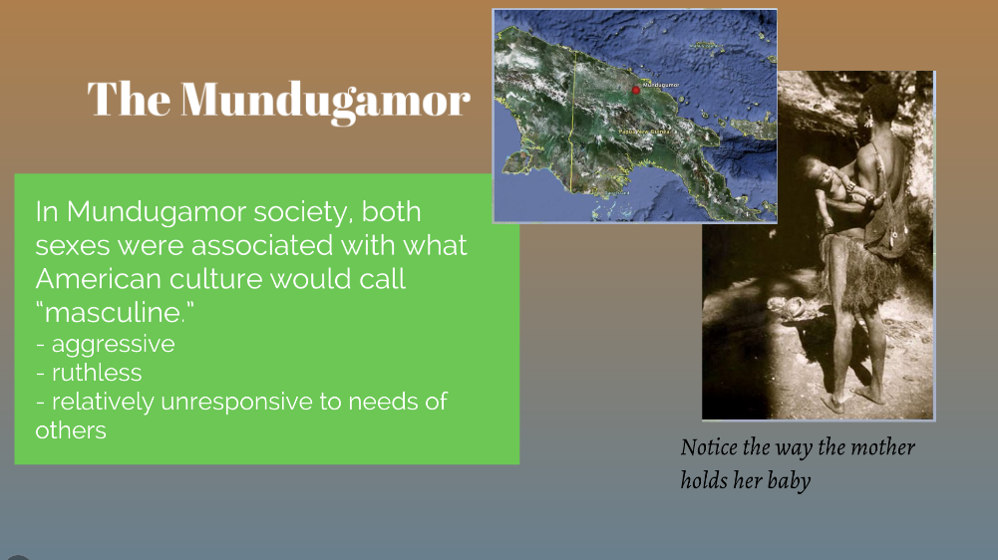

Slide 35
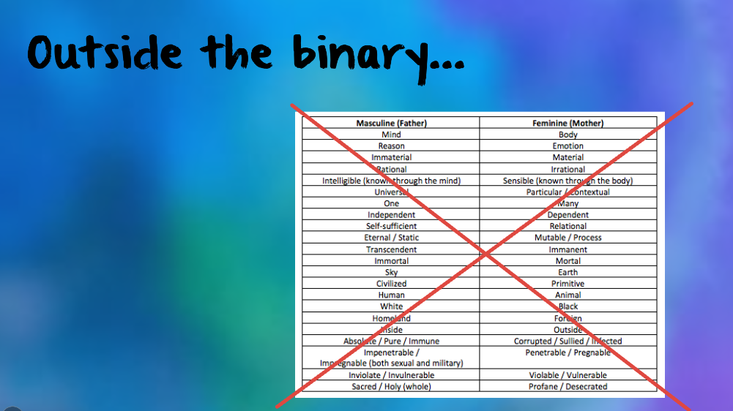

Slide 36
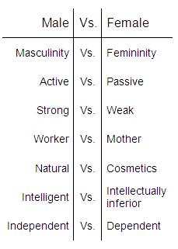
How much of the way humans think about sex and gender has to do with our binary thinking?
To the right is how we are enculturated with norms on gender and sex
It can be very different in other cultures!
  https://www.youtube.com/watch?v=8JcmAoderl4

